Slide 1
GSoC -2021
Project – “Deep autoencoders for ATLAS data compression”
- Vidit Ostwal

Slide 2
INTRODUCTION :
In this task, we were asked to run some raw data, with an already made autoencoder. The task was just to manipulate the data, and not to make a new network for autoencoder.
Data manipulation or data handling includes doing data slicing, normalizing the data, standardizing the data, removing the outliner (abnormal data).
Data manipulation or data handling is important for smooth model processing, uneven data leads either to a very steep gradient descent or very sloppy gradient descent, both which leads to decrease in efficiency of a model.
Various problems which were addressed through data handling:
Each event (a single row)contains a different number of particle information (columns)
, a uniform number of columns are required to read the data in first place , a while function() was made to address the problem.
The data given has a major problem, the last particle ‘phi’ detail is separated with next particle ‘type’ detail is separated with just a ‘;’, but both the information are combined together and put into a single cell, two delimiter were used while reading the data.

Slide 3
Another major problem is that each event has more than one particle information, all these information need to be sliced and stacked row by row, data was sliced column by column to accomplish this task.
We have variety of object type in our data, data was again sliced row to row to slice the data with particle of ‘j’ (jet) type.
Only one dataset is given, that’s why the dataset was broken into train data and test data, in a 80:20 ratio with help of train_test_split().
Data given needs to be scaled or normalized for smooth gradient descent, data was pre-processed with MinMaxScaler(), ( x – xmin )/(xmax –xmin ) , all the values will range in between (0-1) before feeding to the model.
The standardizing of data was done separately to train data and test data after splitting the dataset, to avoid any type of biasness that one dataset can have on the other dataset.
The following table tells about the quality (mean, minimum, maximum, 25%, 50%, 75% of
train data we are given:

Slide 4
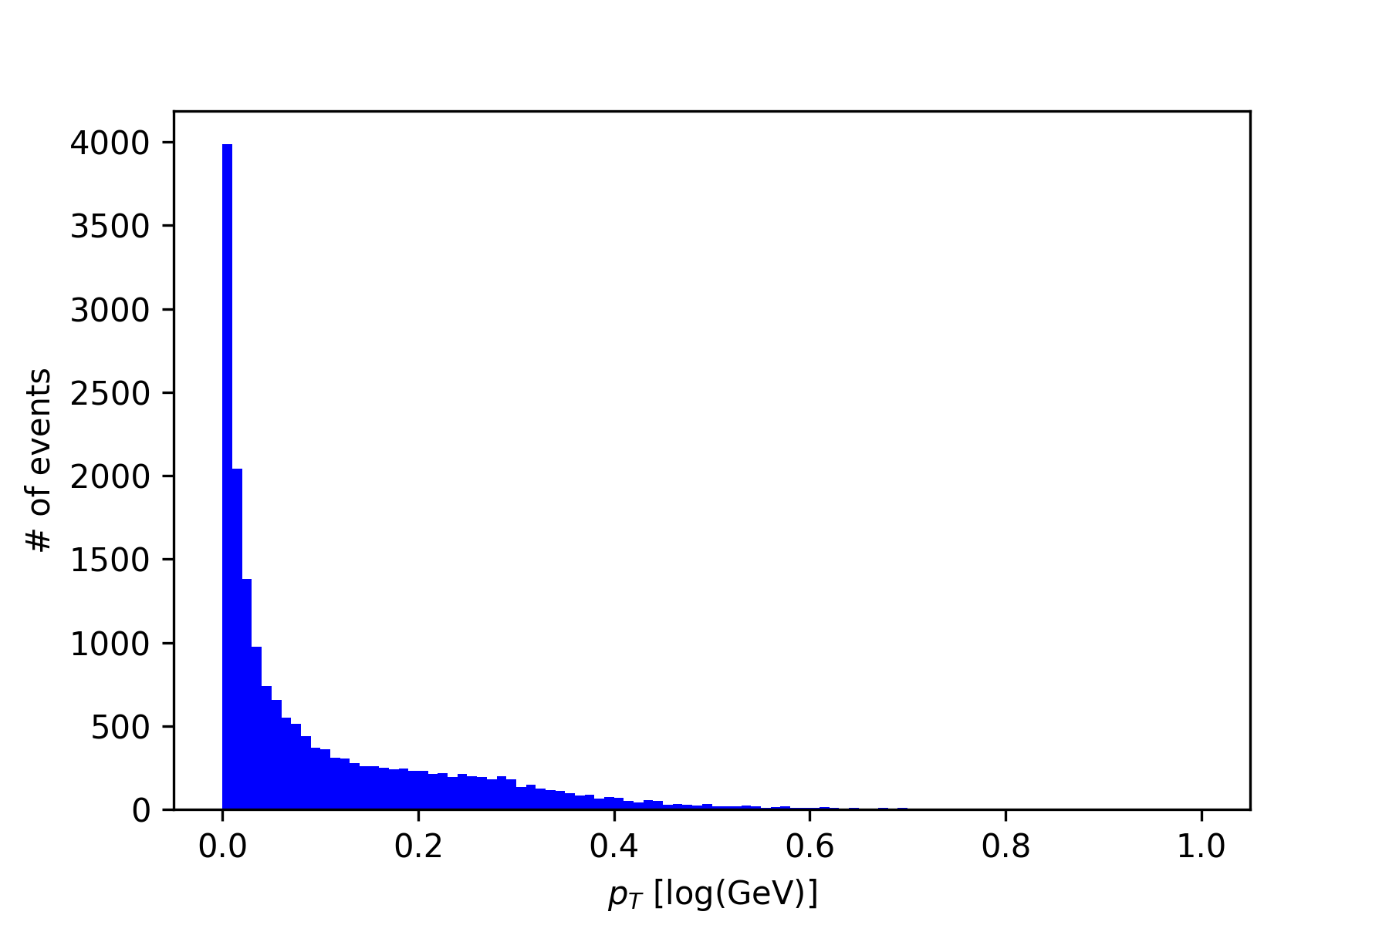
 | pt | Eta | Phi | m
count | 18128.000000 | 18128.000000 | 18128.000000 | 18128.000000
mean | 0.106679 | 0.504778 | 0.498833 | 0.094164
std | 0.129300 | 0.157493 | 0.288255 | 0.097248
min | 0.000000 | 0.000000 | 0.000000 | 0.000000
25% | 0.012366 | 0.403185 | 0.248296 | 0.021583
50% | 0.049208 | 0.505298 | 0.500561 | 0.061598
75% | 0.166752 | 0.607624 | 0.746794 | 0.137735
Table 1:
The mean of ‘pt’ momentum and ‘m’ momentum are very near to zero, thus both graph will have a lot of data values near the value of zero and will represent a ‘half mountain’
The Standard deviation in ‘phi’ is highest and thus the most scattered data will be of ‘phi’ graph.
Graph 1:
‘pt’ momentum of all the particle information given.
The graph clearly shows the most of the particle’s ‘pt’ momentum is near zero, which means the difference between x and xmean for most of the data is very low, which means that number of data we have in between xmin and xmean is much higher than number of data values in-between xmax and xmean This unevenness in the data makes the graph a half mountain.

Slide 5
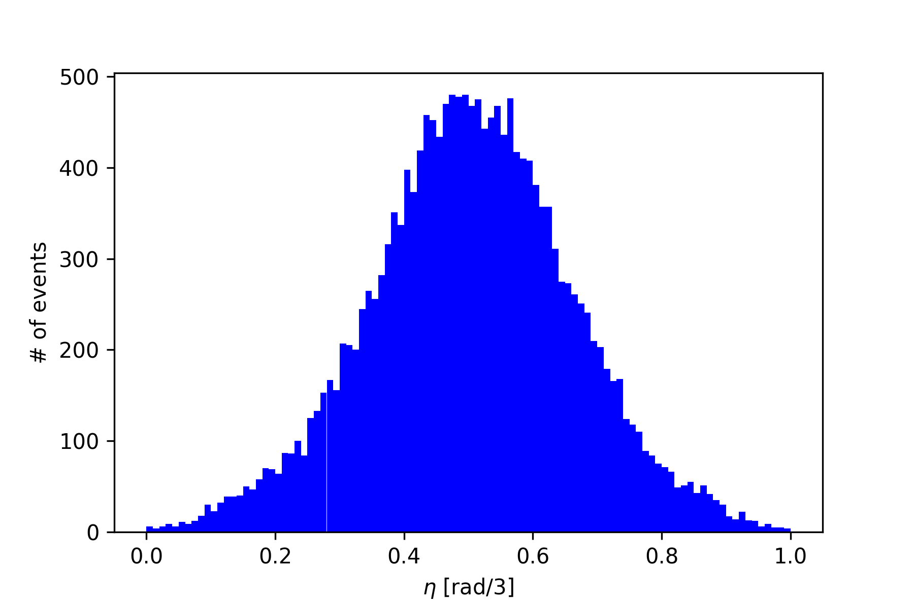
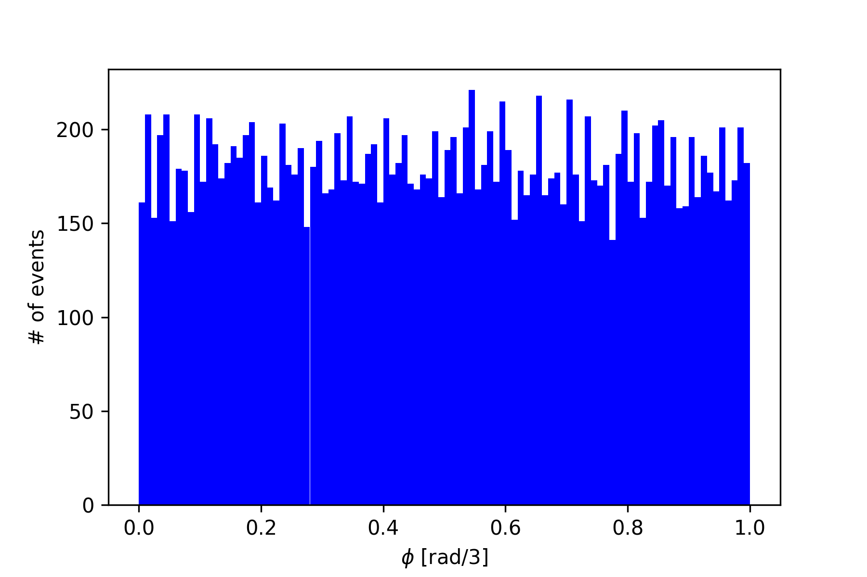
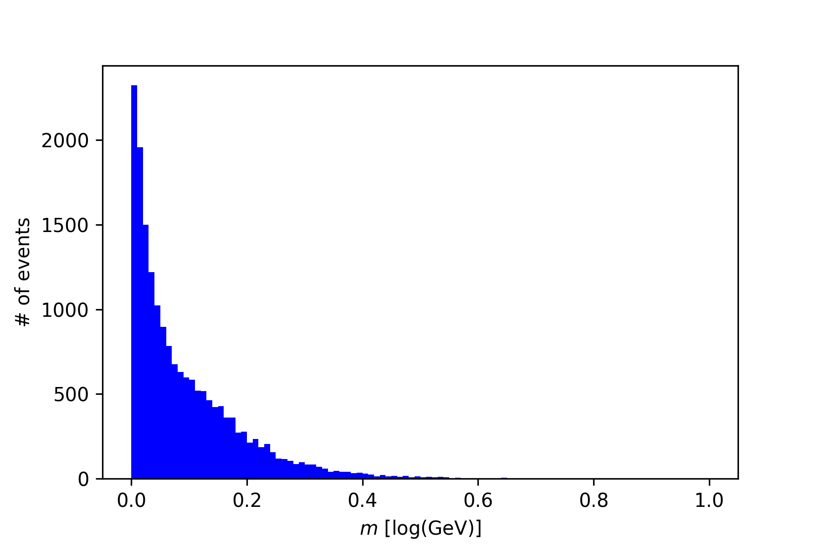
Graph 2:
‘eta’ momentum of all the particle information given.
The graph is more like a full mountain, which depicts that all the values are evenly distributed around the mean of the data given.
Graph 3:
‘phi’ momentum of all the particle information given.
The standard deviation from table 1, is highest of all, which tells that the data is more scattered and thus instead of having a mountain type structure we have more continuous small-building type structure.
Graph 4:
‘m’ momentum of all the particle information given.
The mean of the ‘m’ from table 1, is very less around 0.1, this depicts that more data points are in between xmin and xmean as compared to xmax and xmean
.This unevenness in the data around the mean makes the graph a Half-mountain type.

Slide 6
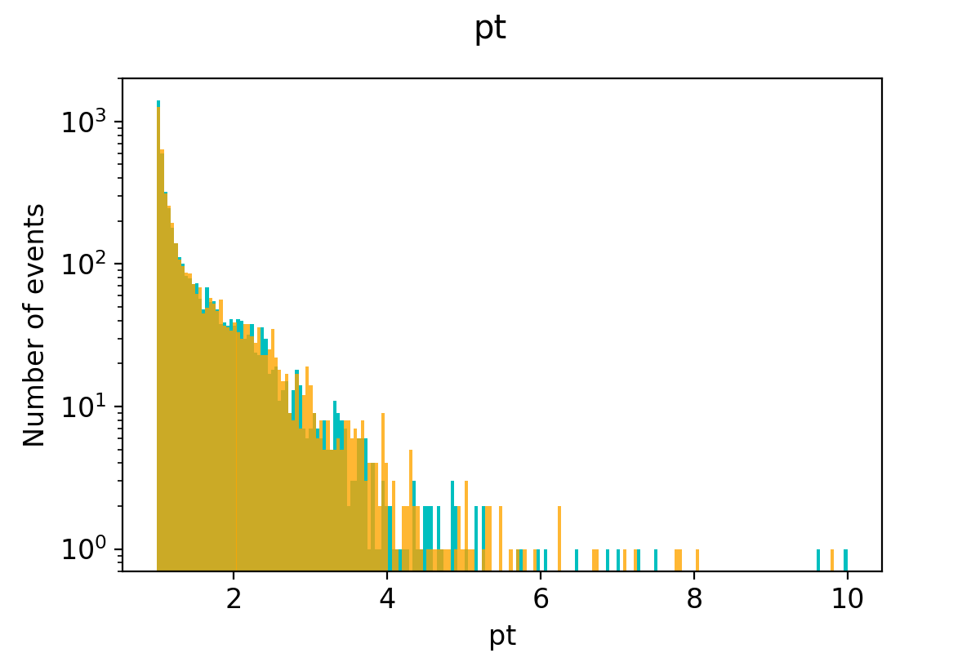
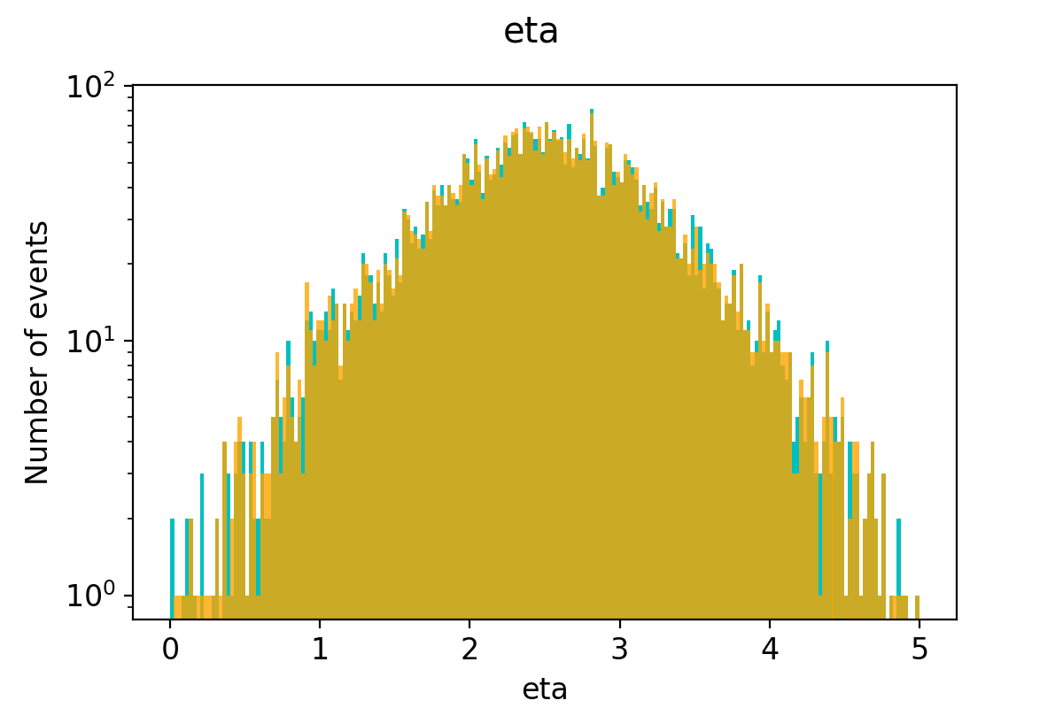
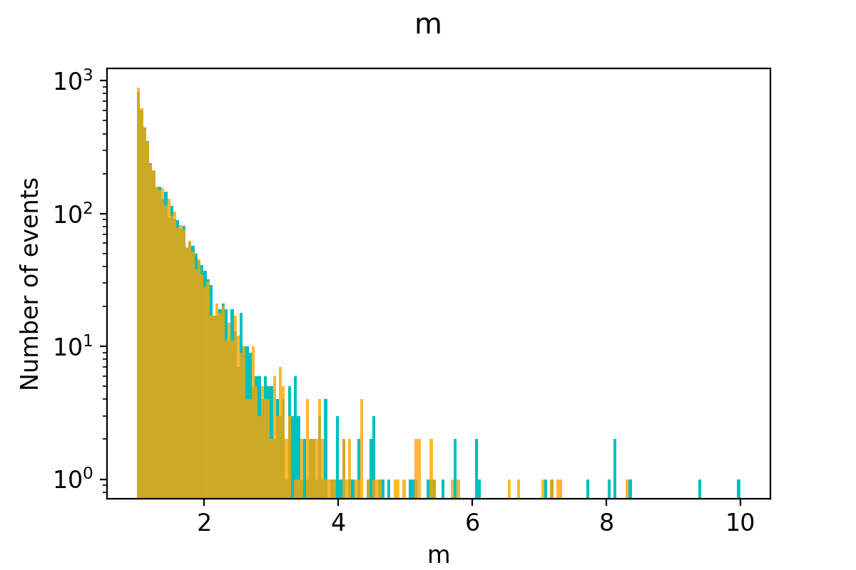
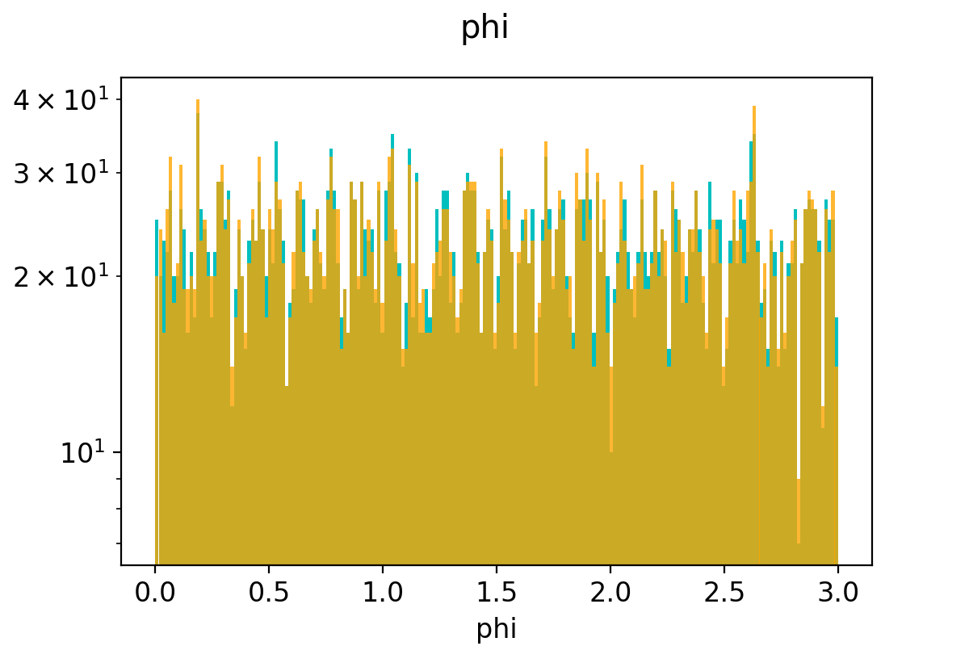

The train dataset was now fed to train the already – provided autoencoder.
The test dataset was given to check the efficiency of the autoencoder.
The following graphs were obtained when the predicted momentum and already given momentum of test dataset were compared
The orange line given are the predicted momentum one.
The cyan line given are the actual one.
The yellow-greenish region is the region of overlap, this region tells how much the predicted and actual momentum meet.
As we can see from the graph, the yellowish- greenish region is predominant in all of the graph, which clearly depicts that our encoding-decoding compression algorithm has worked very well,
This inference is also depicted when validity of the predicted value were compared with the code, the value obtained is less than 0.001, which tells that our compression algorithm worked very well.

